Slide 1


307401 Big Data and Data Warehouses
Introduction to Hadoop

Slide 2
Introduction to the MapReduce Ratings Breakdown Function
In this presentation, we will explore a MapReduce job designed to analyze and count movie ratings from a large dataset. The function is implemented in Python using the mrjob library, which simplifies the creation and execution of MapReduce jobs.
Objective
The primary goal of this function is to determine the number of ratings each movie has received. This analysis is crucial for understanding user engagement and popularity of movies within a dataset, which can be utilized for various analytical purposes such as recommendation systems, trend analysis, and more.
Process Overview
1. Mapping Phase:
The dataset consists of lines where each line contains a user ID, movie ID, rating, and timestamp, separated by tabs.
In the mapper function, each line is parsed to extract the movie ID.
For each movie ID, the mapper emits a key-value pair (movieID, 1), indicating that a rating has been recorded for that movie.
2. Shuffling and Sorting Phase:
The MapReduce framework automatically handles the intermediate step of shuffling and sorting the key-value pairs.
During this phase, all key-value pairs with the same key (movie ID) are grouped together and prepared for the reducing phase.

Slide 3
Introduction to the MapReduce Ratings Breakdown Function
3. Reducing Phase:
The reducer function processes each group of key-value pairs.
For each movie ID, it sums the values to count the total number of ratings.
The reducer then emits a key-value pair (movieID, total_count), representing the total number of ratings for that movie.
Benefits
Scalability: The MapReduce paradigm allows processing of very large datasets by distributing the work across a cluster of machines.
Efficiency: The mrjob library abstracts much of the complexity involved in handling large-scale data processing, making it easier to write and manage MapReduce jobs.
Insightful Analysis: By counting movie ratings, we can gain valuable insights into viewer preferences and movie popularity, which can inform business decisions and enhance user experiences.

Slide 4
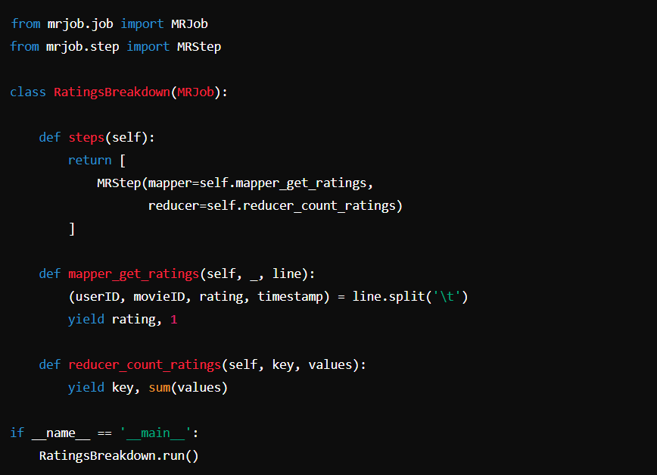
Map Reduce Movie Count Example

Slide 5
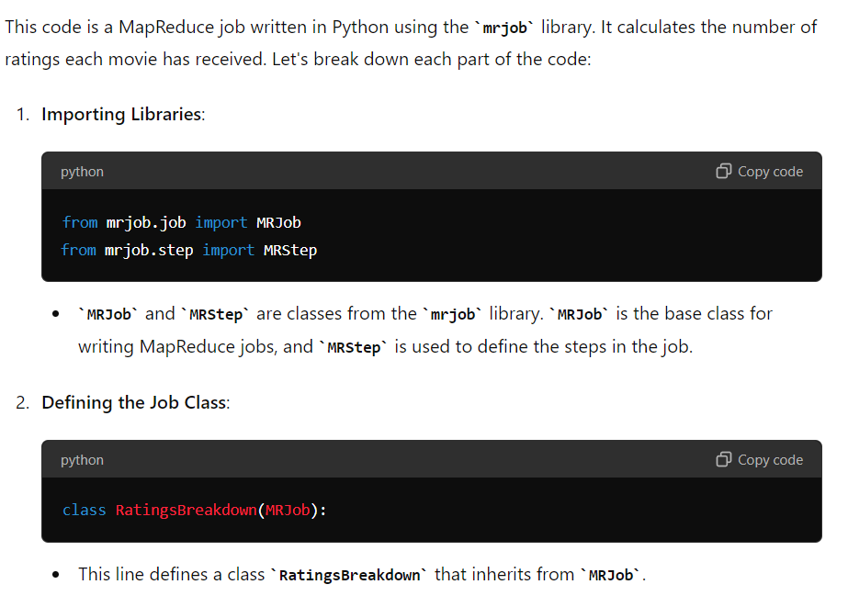
Code Explanation

Slide 6
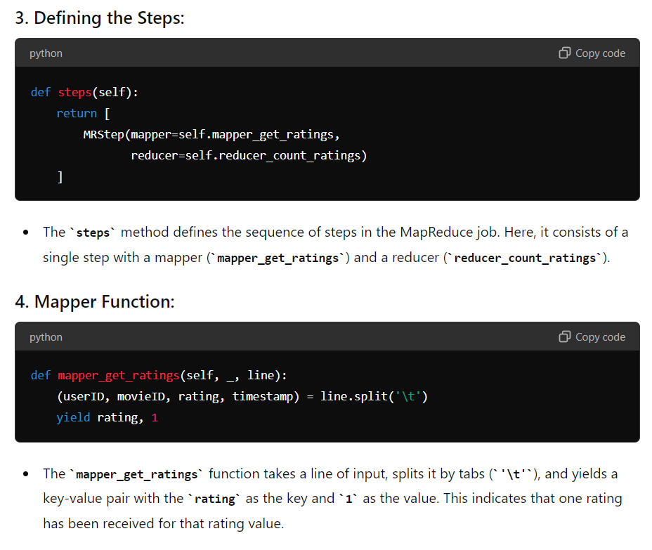
Code Explanation

Slide 7
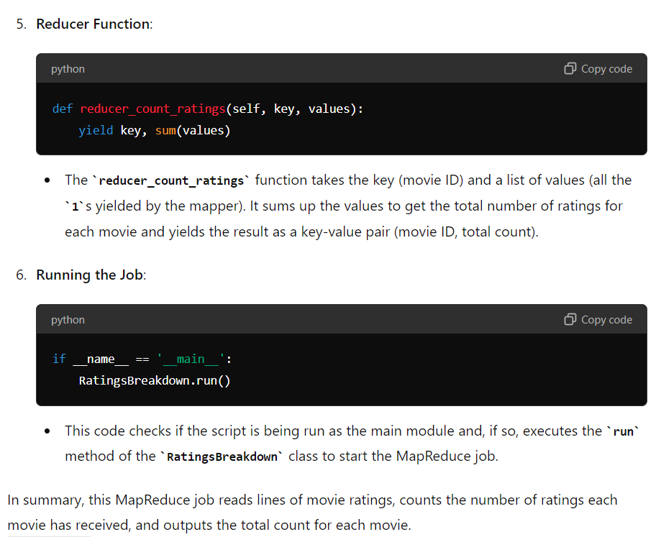
Code Explanation

Slide 8
Execution Flow in Brief
1. Initialization: when we run the script with python RatingsBreakdown.py u.data, mrjob initializes the job and prepares to process the input file.
2. Input Handling: mrjob reads the u.data file in chunks. Each chunk consists of multiple lines of the file.
3. Mapper Execution: for each chunk, mrjob processes each line within the chunk, invoking the mapper_get_ratings method for each line. The mapper emits key-value pairs (movieID, 1).
4. Shuffling and Sorting: the intermediate key-value pairs are collected and sorted by mrjob. This sorting is essential for grouping values by key before they are sent to the reducer.
5. Reducer Execution: the sorted key-value pairs are fed into the reducer_count_ratings method. The reducer aggregates the values for each key and emits the final count of ratings for each movie.
6. Output: the final output is written to standard output or a specified output file.

Slide 9
Distributed Processing in MapReduce
Mapping:
Mapper Nodes: Multiple nodes in the cluster are designated as mapper nodes. Each mapper node processes a portion of the input data, typically a split or chunk of the entire dataset.
Execution: The mapper_get_ratings function is executed on each line of the input split assigned to a mapper node. The mapper produces intermediate key-value pairs (movieID, 1 in this case).
Shuffling and Sorting:
Intermediate Storage: After the mapper phase, the intermediate key-value pairs are stored temporarily on local disks of the mapper nodes.
Shuffle Phase: The framework (e.g., Hadoop) automatically handles the shuffle phase, which involves transferring intermediate key-value pairs from mapper nodes to reducer nodes. During this phase, data is sorted and grouped by key. All values associated with a particular key are brought together on the same reducer node.
Sorting: This phase ensures that the input to each reducer is sorted by key, which is necessary for the reducer to process the data correctly.
Reducing:
Reducer Nodes: Different nodes in the cluster are designated as reducer nodes. Each reducer node processes a subset of the keys and their associated values.
Execution: The reducer_count_ratings function is executed on the grouped key-value pairs. For each key (movieID), the reducer aggregates the values (counts the number of ratings) and produces the final output key-value pairs (movieID, total count).
Output:
The final output from each reducer node is written to the distributed file system (e.g., HDFS in Hadoop) or another specified output location.

Slide 10
Example Execution Flow
Input Splitting:
The input file (u.data) is split into several chunks. Each chunk is processed by a different mapper node.
Mapping Phase:
Mapper Node 1 processes split 1:
Reads lines, applies mapper_get_ratings, and produces intermediate key-value pairs.
Mapper Node 2 processes split 2:
Reads lines, applies mapper_get_ratings, and produces intermediate key-value pairs.
This continues for all splits.
Shuffling and Sorting:
Intermediate key-value pairs are shuffled such that all pairs with the same key (movieID) are sent to the same reducer node.
Data is sorted by key during this phase.
Reducing Phase:
Reducer Node 1 processes keys (movieIDs) assigned to it:
Applies reducer_count_ratings to aggregate values and produce final output.
Reducer Node 2 processes other keys assigned to it:
Applies reducer_count_ratings to aggregate values and produce final output.
This continues for all keys.
Final Output:
The output from each reducer node is combined to form the final result, typically stored in a distributed file system.

Slide 11
Execution in a Cluster
Cluster Setup:
The cluster consists of multiple nodes. Some nodes are designated as mapper nodes, while others are designated as reducer nodes.
Data Distribution:
The input data is split and distributed across the mapper nodes.
Map Task:
Each mapper node runs the mapper_get_ratings function on its assigned data split.
Intermediate key-value pairs are generated and stored locally.
Shuffle and Sort:
The framework handles the transfer of intermediate key-value pairs from mappers to reducers.
Data is sorted and grouped by key during this phase.
Reduce Task:
Each reducer node runs the reducer_count_ratings function on its assigned keys and values.
Final output key-value pairs are generated.
Output Storage:
The final output is stored in the distributed file system or another specified location.
Conclusion
The MapReduce framework, facilitated by libraries like mrjob, abstracts the complexities of distributed processing, allowing you to focus on writing the mapper and reducer functions. The framework handles data distribution, task scheduling, and fault tolerance, ensuring efficient processing of large datasets across a cluster of nodes.

Slide 12
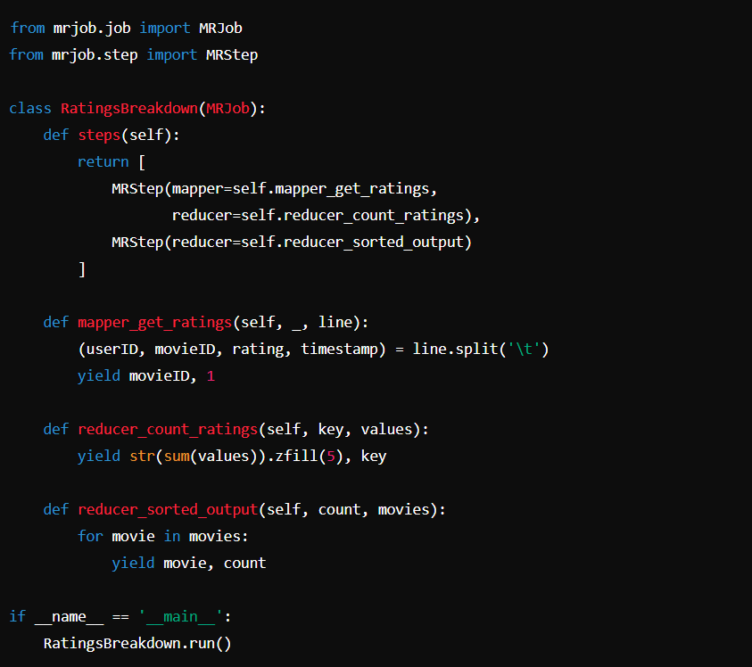
Sort Movies by Rating
The steps method defines a sequence of steps the MapReduce job will perform. Here, there are two steps:
The first step consists of a mapper (mapper_get_ratings) and a reducer (reducer_count_ratings).
The second step consists of only a reducer (reducer_sorted_output).

Slide 13
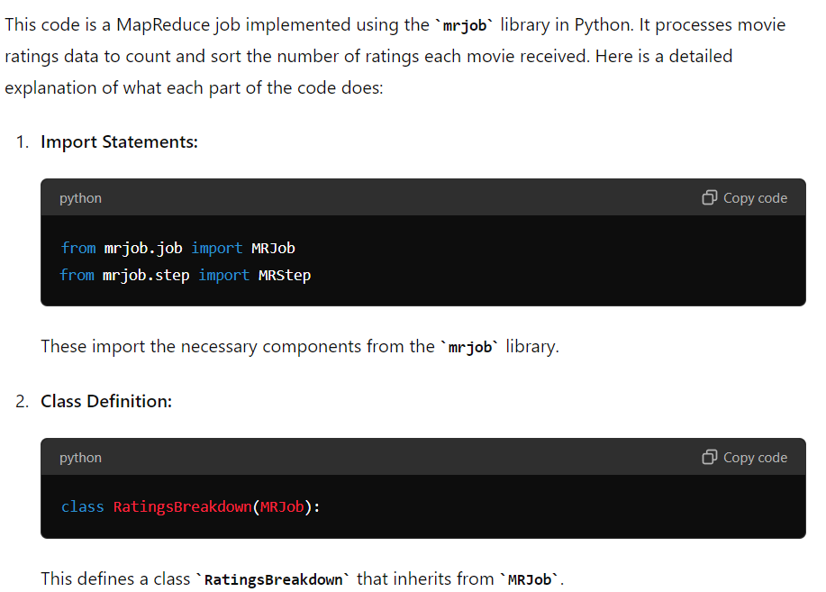
Sort Movies by Rating

Slide 14
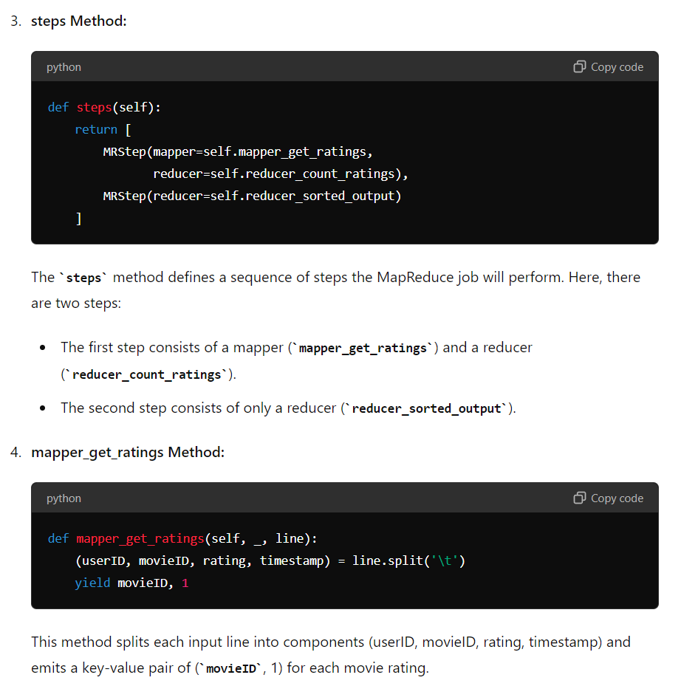
Sort Movies by Rating

Slide 15
